Slide 1
HOMEWORK #6

Slide 2
Collective Work and Interpretation

Slide 3
ICE #10 (part 1)
Open OLS1.pdf
Select a model
Correctly interpret one of the coefficients in that model
Open Logistic Regression.pdf
Select a model
Correctly interpret one of the coefficients in that model

Slide 4
Moderation (Interactions)

Slide 5
Moderation
The combined effect of two variables on another is known conceptually as moderation, and in statistical terms as an interaction effect.

Slide 6
Example
Do violent video games make people aggressive?
Participants
442 youths
Outcome
Aggression,
Callous unemotional traits
Number of hours spent playing video games per week

Slide 7
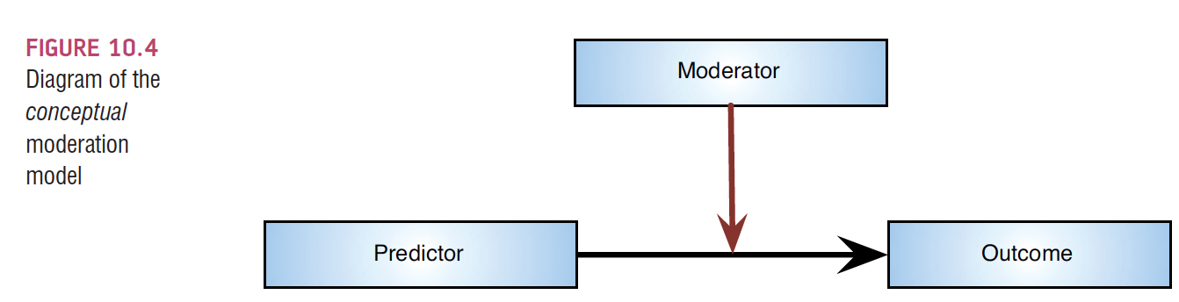
Conceptual moderation model
If callous-unemotional traits were a moderator then we’re saying that the strength (and/or direction) of the relationship between game playing and aggression is affected by callous-unemotional traits.

Slide 8
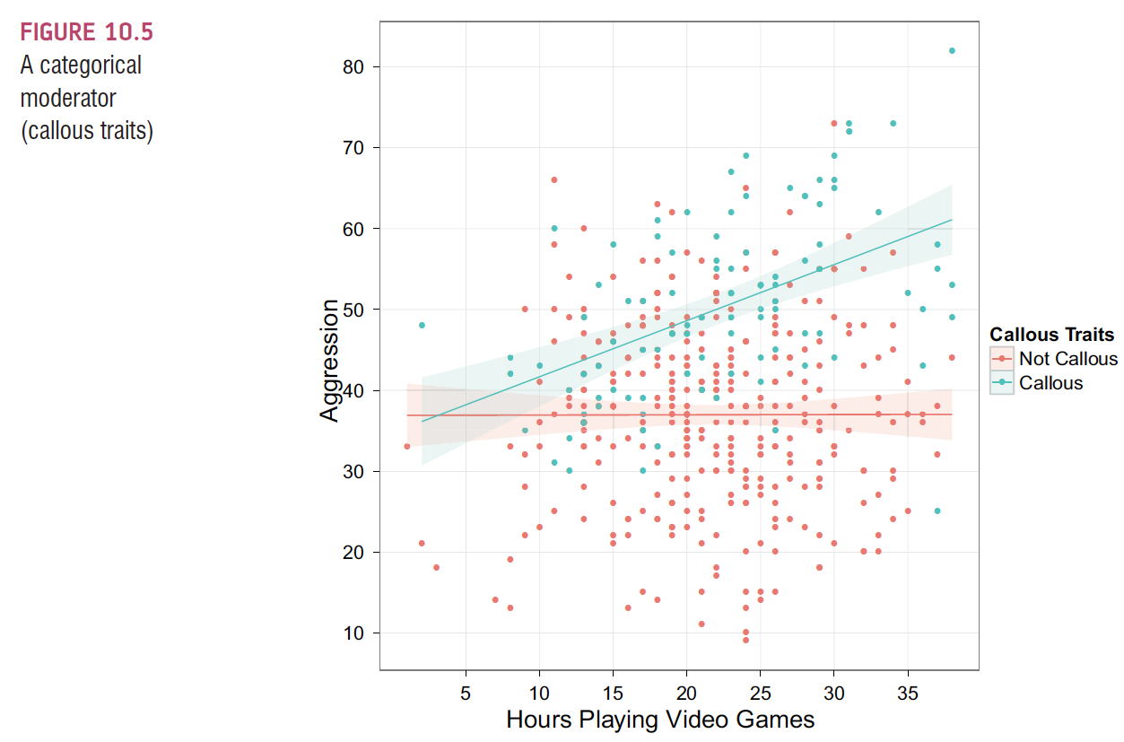
Notes:
So we say that the effect of playing videogames on aggressive behavior is stronger for callous kids (compared to non-callous kids)

Slide 9
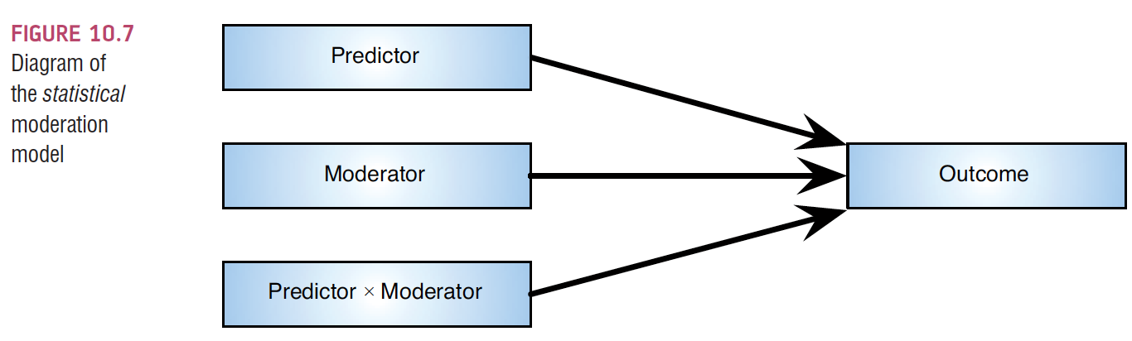
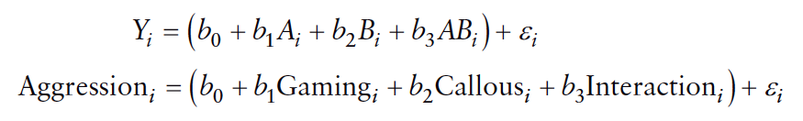
The Statistical Moderation Model

Slide 10
Centering variables
The interaction term makes the bs for the main predictors uninterpretable in many situations.
For this reason, it is common to transform the predictors using mean centering.
transforming a variable into deviations around the mean.

Slide 11
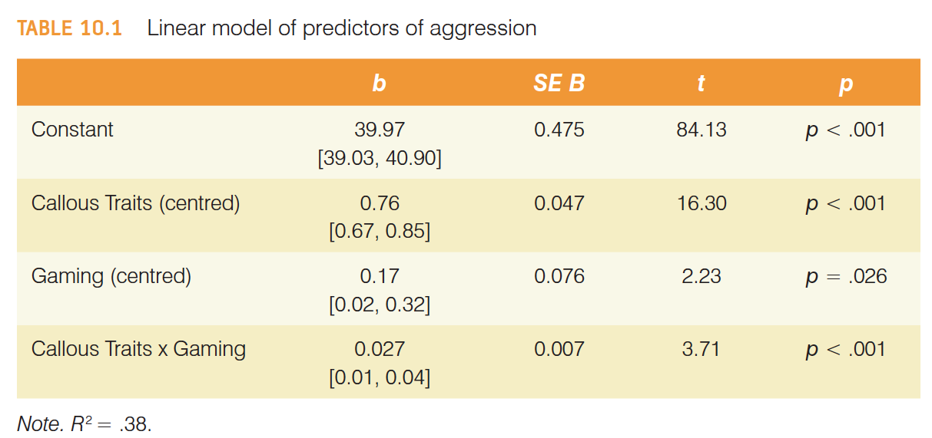
Reporting moderation analysis

Slide 12
ICE #10 (part 2)
Open OLS2 w Interaction.pdf
Select a model
Correctly interpret one of interaction coefficients in that model
Also interpret the main effects (the components of the interaction) for that model

Slide 13
Categorical Predictors in Regression
Often you will have categorical predictors that have more than two categories.
These groups cannot be distinguished using a single variable coded with zeros and ones. Therefore, we use what’s called dummy variables.

Slide 14
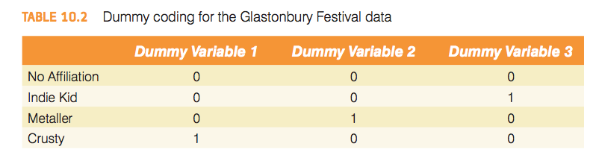
Dummy coding for the Glastonbury Festival data

Slide 15
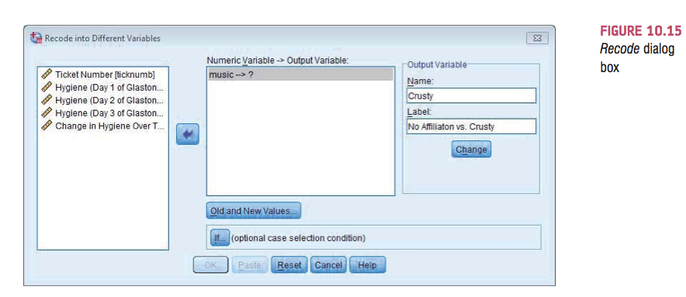

Slide 16
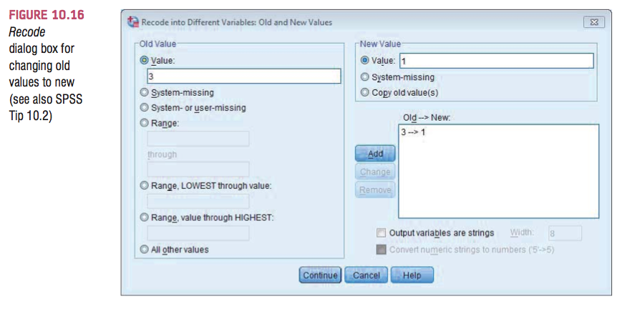

Slide 17
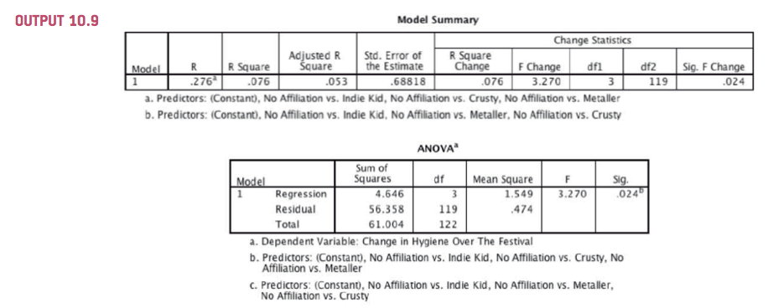
SPSS Output for Dummy Variables

Slide 18
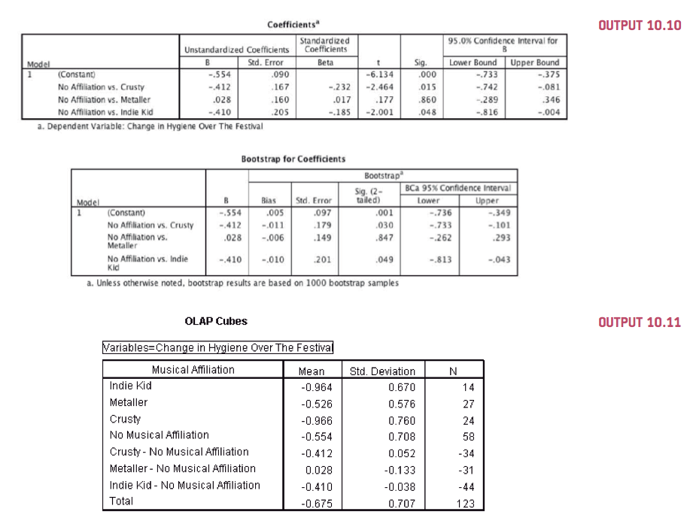
SPSS Output for Dummy Variables II

Slide 19
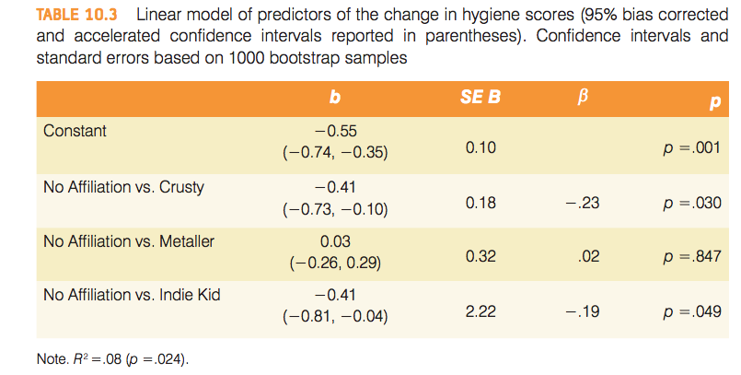
Reporting Results

